Slide 1
Python Programming - II
-By Nimesh Kumar Dagur, CDAC, India

Slide 2
Python Strings
Strings in Python are identified as a contiguous set of characters in between quotation marks.
Python allows for either pairs of single or double quotes.
Subsets of strings can be taken using the slice operator ( [ ] and [ : ] ) with indexes starting at 0 in the beginning of the string and working their way from -1 at the end.
The plus ( + ) sign is the string concatenation operator and the asterisk ( * ) is the repetition operator

Slide 3
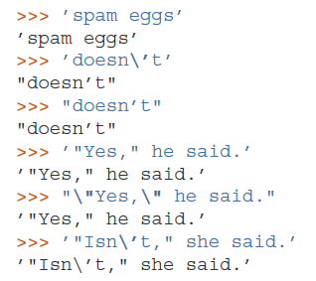
Working With Strings
Besides numbers, Python can also manipulate strings, which can be expressed in several ways.
They can be enclosed in single quotes or double quotes:

Slide 4
Working With Strings
String literals can span multiple lines in several ways.
Continuation lines can be used, with a backslash as the last character on the line indicating that the next line is a logical continuation of the line:
Note that newlines still need to be embedded in the string using \n; the newline following the trailing backslash is discarded.
strings can be surrounded in a pair of matching triple-quotes: """ or ”’.
End of lines do not need to be escaped when using triple-quotes, but they will be included in the string.

Slide 5
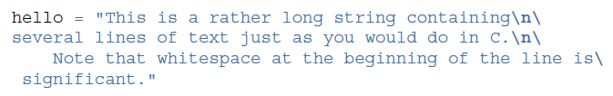

Working With Strings

Slide 6
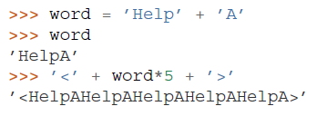
Working With Strings
Strings can be concatenated with the + operator, and repeated with *:

Slide 7
Working With Strings
Two string literals next to each other are automatically concatenated;
the first line above could also have been written
word = ’Help’ ’A’;
this only works with two literals, not with arbitrary string expressions:

Slide 8
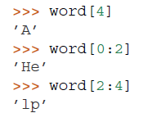
Working With Strings
Strings can be subscripted (indexed); like in C, the first character of a string has subscript (index) 0.
substrings can be specified with the slice notation: two indices separated by a colon.
word=“HelpA”

Slide 9
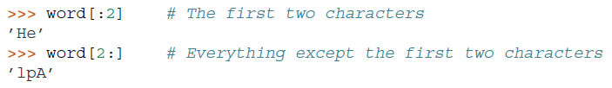
Working With Strings
Slice indices have useful defaults; an omitted first index defaults to zero, an omitted second index defaults to the size of the string being sliced.

Slide 10


Working With Strings
creating a new string with the combined content is easy and efficient:
Here’s a useful invariant of slice operations:
s[:i] + s[i:] equals s.

Slide 11
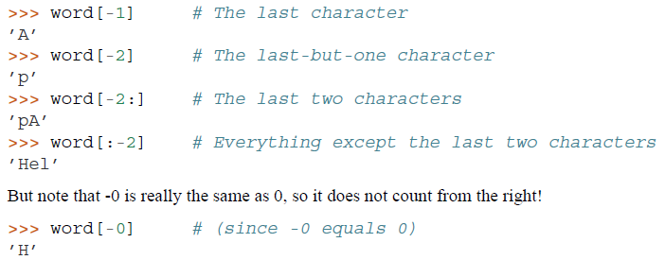
Working With Strings
Indices may be negative numbers, to start counting from the right.

Slide 12

Working With Strings
The built-in function len() returns the length of a string:

Slide 13
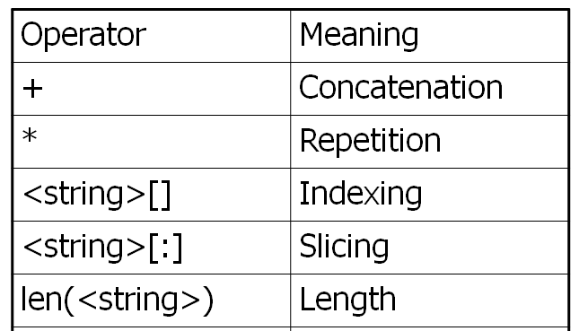
String Data Type

Slide 14
String Formatting Operator
One of Python's coolest features is the string format operator %.
This operator is unique to strings and makes up for the pack of having functions from C's printf() family
(
)

Slide 15
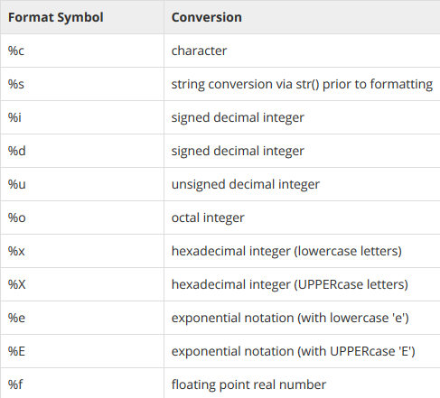
String Formatting Operator
List of set of symbols which can be used along with %

Slide 16
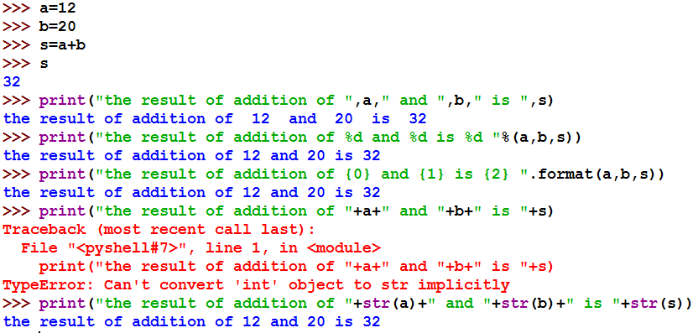
String Formatting : Example(s)

Slide 17

Built-in String Methods
capitalize(): It returns a copy of the string with only its first character capitalized.
str.capitalize ( )
(
)

Slide 18

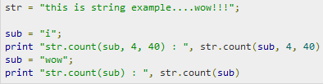

Built-in String Methods
count(): The method count() returns the number of occurrences of substring sub in the range [start, end].

Slide 19

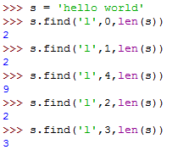
Built-in String Methods
find(): It determines if string str occurs in string, or in a substring of string if starting index beg and ending index end are given.
,
Index if found and -1 otherwise.

Slide 20


Built-in String Methods
lower(): The method lower() returns a copy of the string in which all case-based characters have been lowercased.

Slide 21

Built-in String Methods
upper() :The method upper() returns a copy of the string in which all case-based characters have been uppercased.
swapcase(): The method swapcase() returns a copy of the string in which all the case-based characters have had their case swapped.
title(): The method title() returns a copy of the string in which first characters of all the words are capitalized.
replace() : The method replace() returns a copy of the string in which the occurrences of old have been replaced with new, optionally restricting the number of replacements to max.

Slide 22
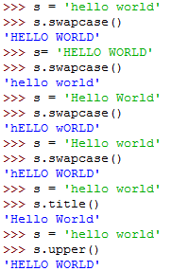
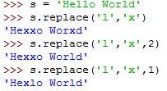

Slide 23
Data Type Conversion
Sometimes, you may need to perform conversions between the built-in types.
To convert between types, you simply use the type name as a function.
There are several built-in functions to perform conversion from one data type to another.
These functions return a new object representing the converted value.

Slide 24
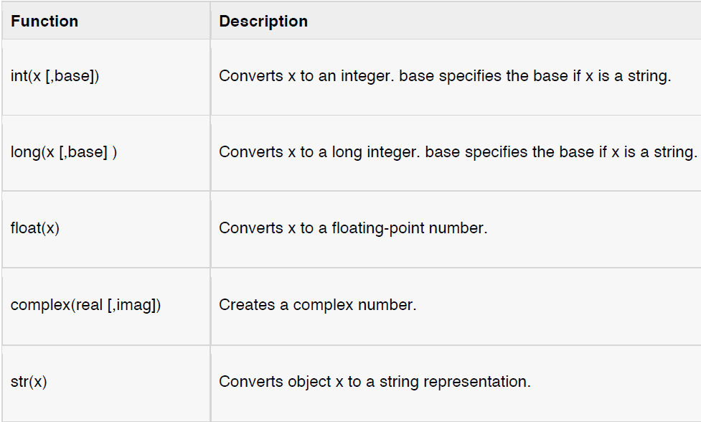
Data Type Conversion

Slide 25
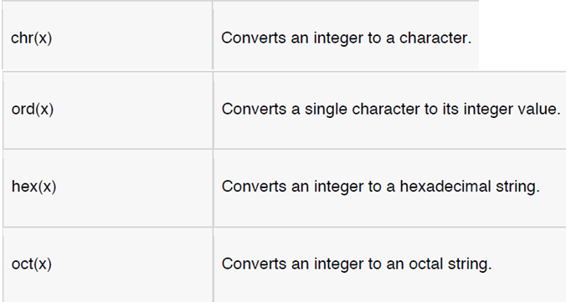
Data Type Conversion

